Slide 1


Javascript
for
makers
Arcadio García Salvadores
Universidad Autónoma de Madrid
@arcadio_g_s
#MSPSpain

Slide 2
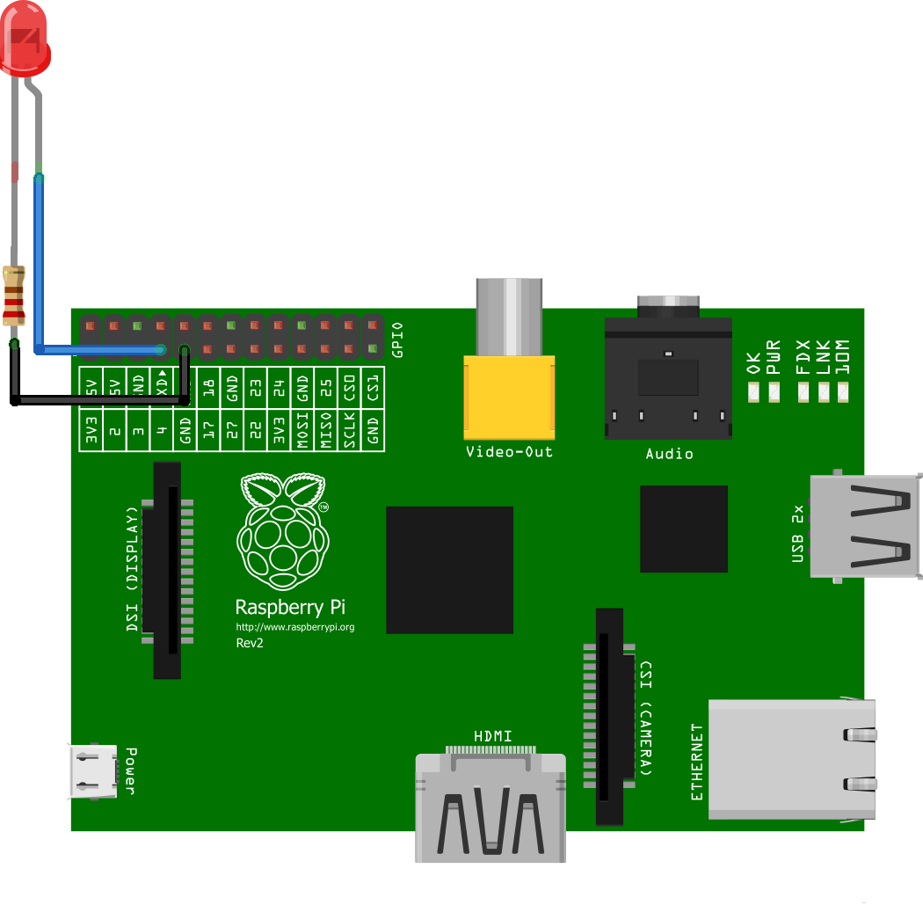
Maker
DIY
IoT
Raspberry PI

Slide 3
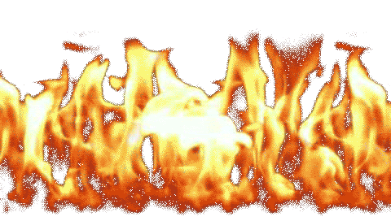
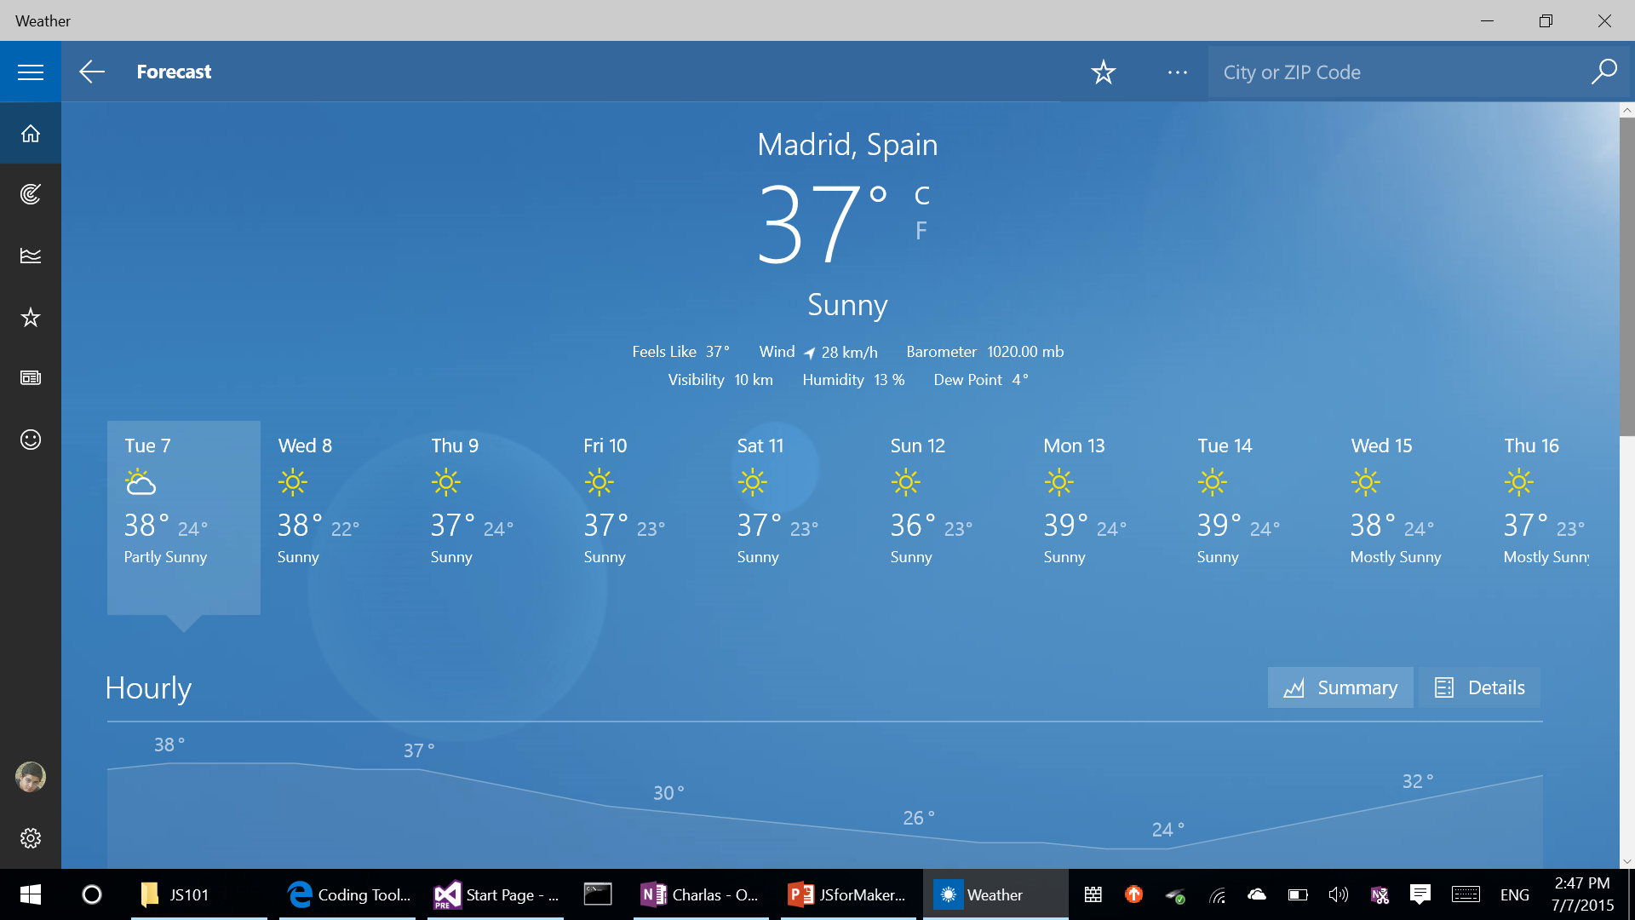

Slide 4


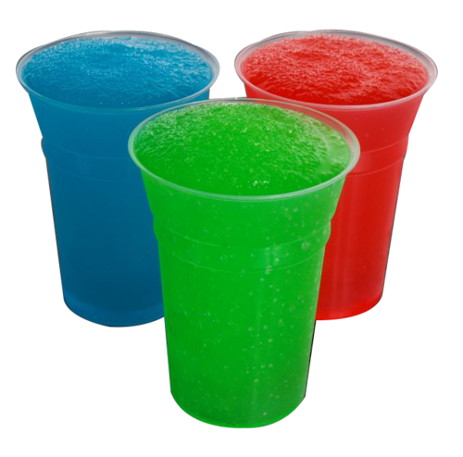

Slide 5
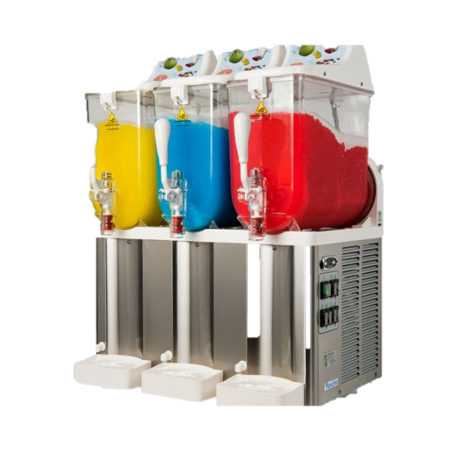
?

Slide 6
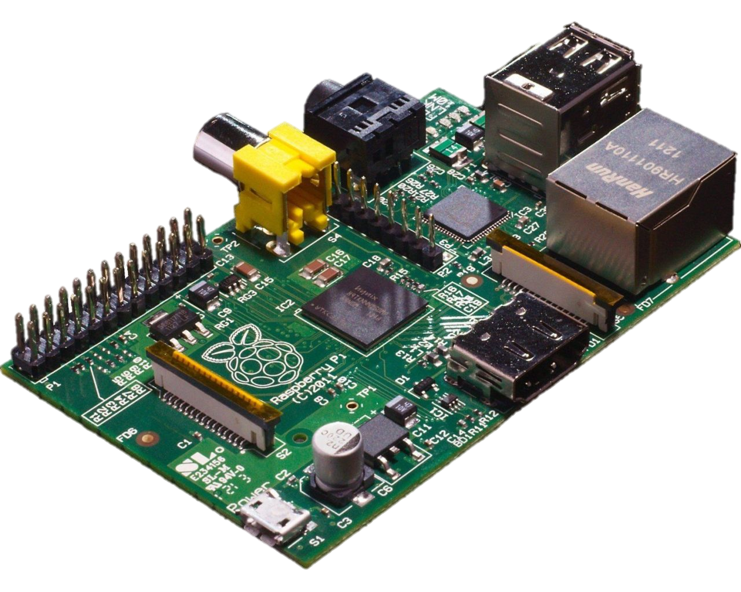
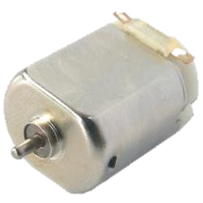
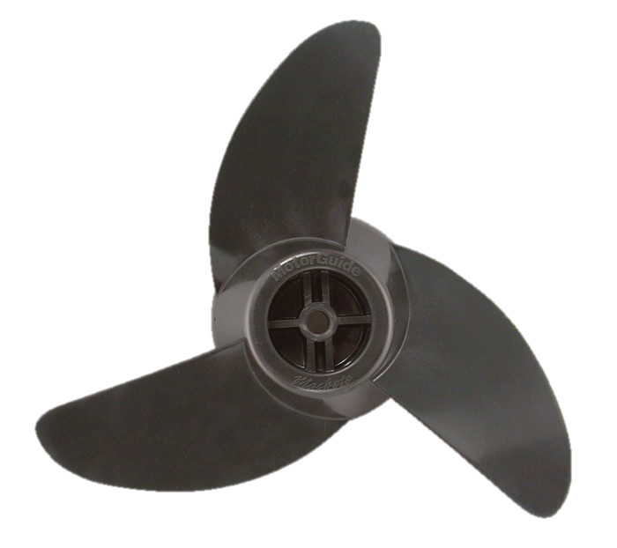
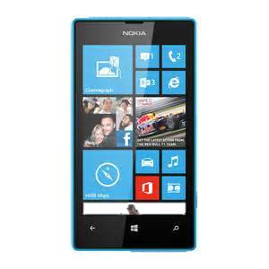



Slide 7

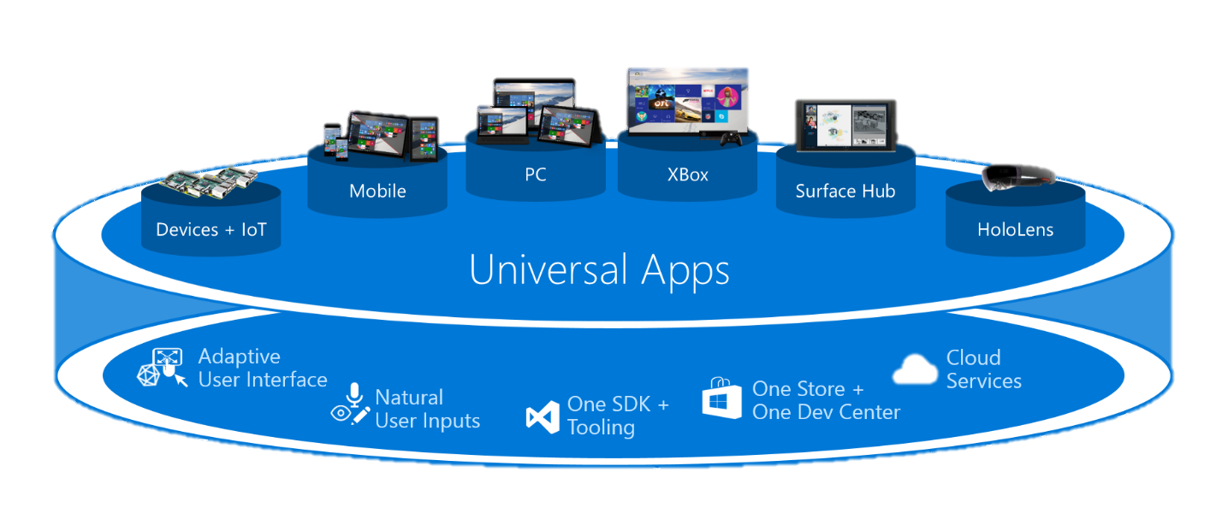

Slide 8
Raspberry Pi (Node.js)
Azure web app (Node.js)
Universal Windows App (JavaScript)

Slide 9
<code>

Slide 10
</code>

Slide 11

https://github.com/arcadiogarcia/SlushAsAService

Slide 12

IoT resources
Reference talks by Sam, Elio, Clemens and any of the ASA talks, at least.
https://dev.windows.com/en-US/iot

